Slide 1

Character Animation
CSE 191A: Seminar on Video Game Programming
Lecture 5: Character Animation
UCSD, Spring, 2003
Instructor: Steve Rotenberg

Slide 2
Animation System
Rigging
Animation
Procedural animation
Dynamics

Slide 3
Rigging

Slide 4
Rigging
Rigging refers to the construction and setup of an animatable character, similar to the idea of building a puppet
A ‘rig’ has numerous degrees of freedom (DOFs) that can be used to control various properties

Slide 5
Skeletons
Hierarchy of bones connected by joints
Joints can provide any linear transform, but simple one degree of freedom (1-DOF) joints are very common. Joints take some number of DOFs as input and generate a joint local matrix M_{local} as a result
World space matrices are computed by a depth-first tree traversal process computing forward kinematics
M_{world}=M_{local}·M_{parent-world}

Slide 6
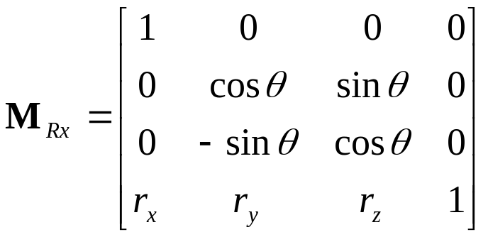
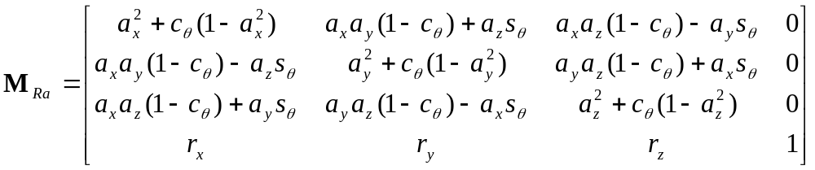
Rotational Joints
Principle axis (x)
Arbitrary axis

Slide 7
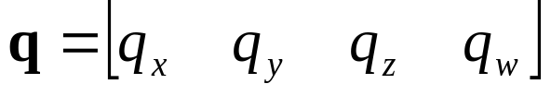
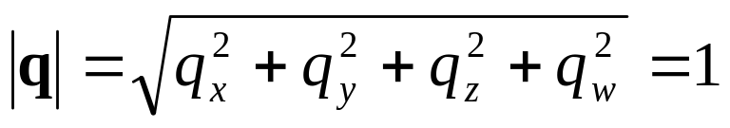
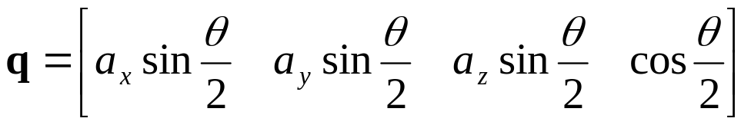
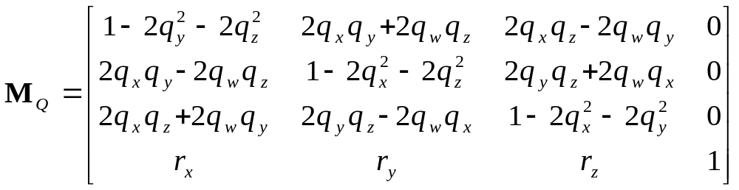
Quaternions

Slide 8
Other Joint Types
Translation
Scale
  Single axis
  Multiple axis
  Volume preserving
Compound joints
  Screw
  Path

Slide 9
Skinning Techniques
Rigid parts
Simple skin
Blended skin
Pose-space deformation
Free-form deformations
Skin & muscle simulation

Slide 10
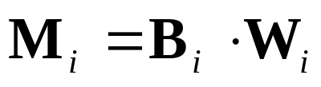
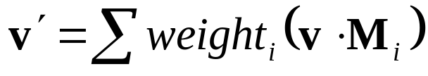
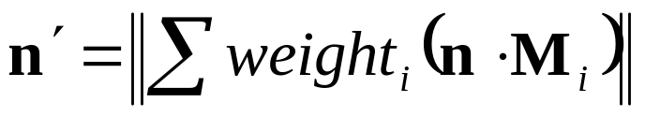
Blended Skin
Also called: skin, smooth skin, skeletal subspace deformation…
Every vertex is attached to one or more matrices with a weight (weights must add up to 1.0)

Slide 11
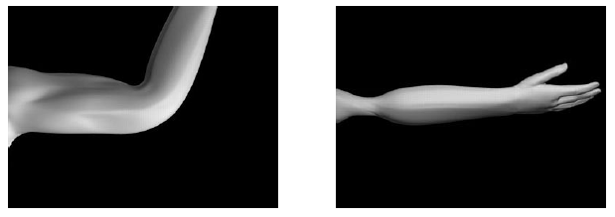
Blended Skin

Slide 12
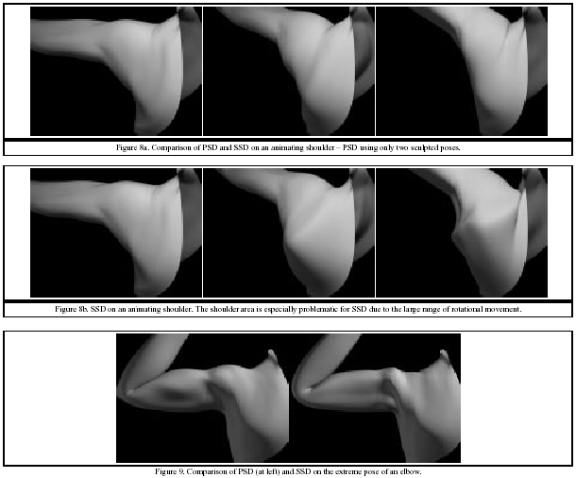
Pose-Space Deformation

Slide 13
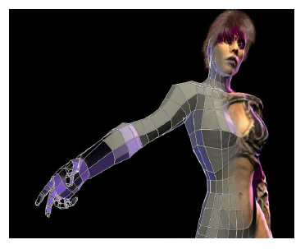
Free Form Deformations
Rectangular lattice deformations
Arbitrary lattice deformations
Axial deformations
Surface deformations

Slide 14
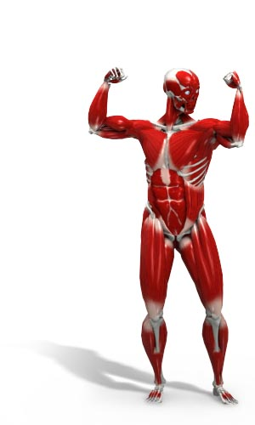
Anatomy
Layers
  Bone
  Muscle
  Fatty tissue
  Skin
  Hair
  Clothing

Slide 15
Facial Animation
Shape interpolation
Parametric blending
Muscle simulation
Wrinkles

Slide 16
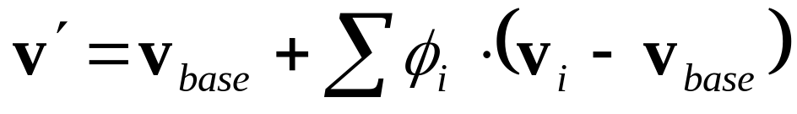
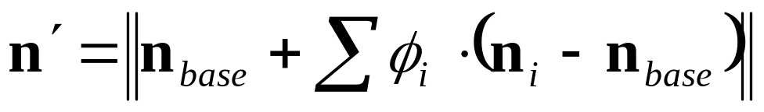
Parametric Blending
Start with a neutral or ‘base’ expression
Create a deformed version of the base mesh for every individual facial parameter (note: you only need to store verts that are not in the base state)

Slide 17
Inverse Kinematics
IK is a method of posing a skeleton where you specify the ‘goal’ of the ‘end effector’ and the algorithm computes the joint angles necessary to reach that goal
Goals can be simple positions or can be position/orientations, or just orientations. They can also be specified in more elaborate ways if desired

Slide 18
Inverse Kinematics
There are a variety of techniques for solving IK problems:
Analytical
Numerical
  Jacobian (inverse, pseudoinverse, transpose)
  Cyclic coordinate descent
  Damped least squares
  Nonlinear optimization

Slide 19
Rigging
A DOF in the rig can be used to pose joint angles, blend targets, IK goals, graphical properties, or any other animatable parameter
DOFs could also be used to control a group of parameters or can offer higher level control through the use of expressions (for example, one ‘DOF’ could open/close the entire hand)
One character could have several rigs. One rig could control several characters…
At its simplest, a rig is basically an array of floats and so it makes a nice clean interface between the animation layer and the rigging layer

Slide 20
Animation

Slide 21
Channels
A ‘channel’ is a DOF value changing over time
Usually, a channel is stored in some explicit representation:
  Keyframes
  Raw data
  Delta compression
An ‘animation’ is a collection of channels that maps to a particular character
A ‘frame’ represents the complete set of DOF values needed to pose a character for a particular instant
Animations can be stored as an array of channels or as an array of frames.

Slide 22
Animation Players
Play, pause, stop
Adjust rate (faster, slower, backwards…)
What to do at end?
  Loop
  Stop
  Hold on last frame
  Trigger some event…

Slide 23
Animation Blending
DOF values and entire frames can be blended in arbitrary ways
Multi-track blending
Localized blending

Slide 24
State Machines
States represent animations
Transitions represent instantaneous events
Transitions can be triggered by:
  End of animation
  Button press
  In-game event (collision…)
  Timers
  Whatever…
State machines can be blended. Blenders can be controlled by state machines…

Slide 25
Animation Layer
The end result of all of the animation playing, blending, and state machine manipulation is a ‘frame’ of DOF values that is used to pose the rig (hopefully, exactly one value for every DOF in the character)
Remember, these DOF values can map to any animatable parameter in the character.

Slide 26
Procedural Animation
Locomotion
Dynamics
Dynamic Control
Procedural Animation
Behavioral Animation

Slide 27
Locomotion
Biped, quadruped, hexapod, arachnid (octapod), centipede…
Digitate, palmate
Quadruped gaits:
  Walk
  Canter, rack/pace, trot
  Gallops (rotary/tranverse, feline/equestrian)
Hexapod gaits
  Back-to-front wave gait
  Tripod gait

Slide 28
Character Production
Concept
Design
Model
Texture
Skeleton
Skinning
LODs
Collision & gameplay setup
Animation
Audio

Slide 29
Conclusion

Slide 30
Preview of Next Week
Play control
Game design
Gameplay & fun

Slide 31
Reading Assignment
“Real Time Rendering”, Chapter 4

Slide 32
Animation References
“Cyclopedia Anatomicae”, Feher
“The Anatomy of Movement”, Calais-Germain
“The Artist’s Complete Guide to Facial Expression”, Faigin
“Animals in Motion”, Muybridge
“Interactive Character Animation”, Rotenberg (2004)

